Slide 1

Unit-3
Android Programming
Building User Interfaces
Fundamental Android UI Design, Android User Interface Fundamentals, Introducing Layouts: LinearLayout, RelativeLayout, GridLayout, TableLayout. Introducing Fragments, and life cycle of Fragment, Introducing Adapters.
KLE Society’s College of BCA RLSI Belagavi

Slide 2
Fundamental Android UI Design
Fallowing are basic components of UI
1. View
A View is an interactive UI component (or widget or control), such as button and text field.
It controls a rectangular area on the screen. It is responsible for drawing itself and handling events (such as clicking, entering texts).
Android provides many ready-to-use Views such as TextView, EditText, Button, RadioButton, etc, in package android.widget. You can also create your custom View by extending android.view.View.
KLE Society’s College of BCA RLSI Belagavi

Slide 3
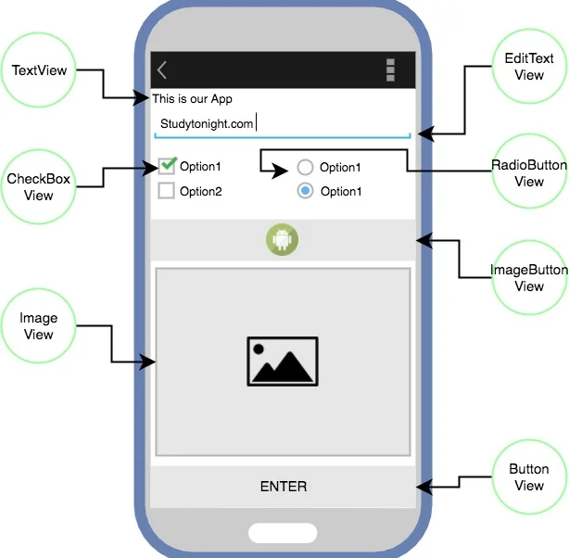
XML syntax for creating a View
To draw anything in your android application, you will have to sepcify it in the design XML files. And to add functionality we will create Java files.
Every view in XML has the following format:
<ViewName
Attribute1=Value1
Attribute2=Value2
Attribute3=Value3
.
.
AttributeN=ValueN
/>
KLE Society’s College of BCA RLSI Belagavi

Slide 4
ViewGroup:
A ViewGroup is an invisible container used to layout the View components.
Android provides many ready-to-use ViewGroups such as LinearLayout, RelativeLayout, TableLayout and GridLayout in package android.widget.
You can also create your custom ViewGroup by extending from android.view.ViewGroup.
Types of layout
There are many types of layout. Some of which are listed below −
ConstraintLayout Android ConstraintLayout is used to define a layout by assigning constraints for every child view/widget relative to other views present
Linear Layout:Linear layout is further divided into horizontal and vertical layout. It means it can arrange views in a single column or in a single row
Table Layout:The TableLayout groups views into rows and columns
Relative Layout:The RelativeLayout enables you to specify how child views are positioned relative to each other
GridLayout:The GridLayout is used to arrange the components in rectangular grid. One component is displayed in each rectangle
KLE Society’s College of BCA RLSI Belagavi

Slide 5
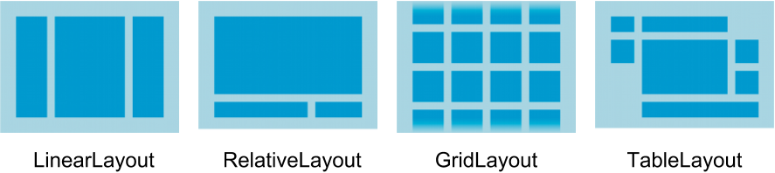
Types of Layout
KLE Society’s College of BCA RLSI Belagavi

Slide 6
3.Activity
An Activity interacts with the user, via a visual UI on a screen. The UI is placed on the Activity via the Activity's setContentView() method.
In Android, the UI composes of View and ViewGroup objects, organized in a single view-tree structure
KLE Society’s College of BCA RLSI Belagavi

Slide 7
Layouts
Android Layout is used to define the user interface that holds the UI controls or widgets that will appear on the screen of an android application or activity screen.
Generally, every application is a combination of View and ViewGroup.
View
A View is defined as the user interface which is used to create interactive UI components such as TextView, ImageView, EditText, RadioButton, etc., and is responsible for event handling and drawing. They are Generally Called Widgets.
KLE Society’s College of BCA RLSI Belagavi

Slide 8
ViewGroup
A ViewGroup act as a base class for layouts and layouts parameters that hold other Views or ViewGroups and to define the layout properties. They are Generally Called layouts.
KLE Society’s College of BCA RLSI Belagavi

Slide 9
Types of Android Layout
Linear Layout
Relative Layout
Constraint Layout
Frame Layout
Table Layout
Grid Layout
KLE Society’s College of BCA RLSI Belagavi

Slide 10
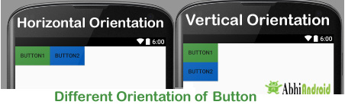
Linear layout
Linear layout is a simple layout used in android for layout designing.
In the Linear layout all the elements are displayed in linear fashion means all the childs/elements of a linear layout are displayed according to its orientation.
The value for orientation property can be either horizontal or vertical.
KLE Society’s College of BCA RLSI Belagavi

Slide 11
There are two types of linear layout orientation:
Vertical
Horizontal
As the name specified these two orientations are used to arrange there child one after the other, in a line, either vertically or horizontally.
1.Vertical:
In this all the child are arranged vertically in a line one after the other. In below code snippets we have specified orientation “vertical” so the childs/views of this layout are displayed vertically.
KLE Society’s College of BCA RLSI Belagavi

Slide 12
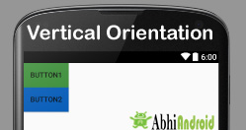
LinearLayout xmlns:android="http://schemas.android.com/apk/res/android"
android:layout_width="fill_parent"
android:layout_height="wrap_content"
android:orientation="vertical"> <!-- Vertical Orientation set -->
<Button
android:layout_width="wrap_content"
android:layout_height="wrap_content"
android:text="Button1"
android:id="@+id/button"
android:background="#358a32" />
<Button
android:layout_width="wrap_content"
android:layout_height="wrap_content"
android:text="Button2"
android:id="@+id/button2"
android:background="#0058b6" />
</LinearLayout>
KLE Society’s College of BCA RLSI Belagavi

Slide 13
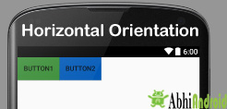
2. Horizontal:
In this all the child are arranged horizontally in a line one after the other.
<LinearLayout xmlns:android="http://schemas.android.com/apk/res/android"
android:layout_width="fill_parent"
android:layout_height="wrap_content"
android:orientation="horizontal"> <!-- Horizontal Orientation set -->
<Button
android:layout_width="wrap_content"
android:layout_height="wrap_content"
android:text="Button1"
android:id="@+id/button"
android:background="#358a32" />
<Button
android:layout_width="wrap_content"
android:layout_height="wrap_content"
android:text="Button2"
android:id="@+id/button2"
android:background="#0058b6" />
</LinearLayout>
KLE Society’s College of BCA RLSI Belagavi

Slide 14
Main Attributes In Linear Layout:
1. orientation: The orientation attribute used to set the childs/views horizontally or vertically. In Linear layout default orientation is vertical.
Ex: android:orientation="vertical"
2. gravity: The gravity attribute is an optional attribute which is used to control the alignment of the layout like left, right, center, top, bottom etc.
Ex: android:gravity="right"
3.layout_weight: The layout weight attribute specify each child control’s relative importance within the parent linear layout.
Ex: android:layout_width="match_parent"
android:layout_width="wrap_content"
4. weightSum: weightSum is the sum up of all the child attributes weight. This attribute is required if we define weight property of the childs.
Ex: android:weightSum="3"
KLE Society’s College of BCA RLSI Belagavi

Slide 15
Example
<Button
android:layout_width="fill_parent"
android:layout_height="wrap_content"
android:text="Button 2"
android:background="#e6cf00" />
<Button
android:layout_width="fill_parent"
android:layout_height="wrap_content"
android:text="Button 3"
android:background="#0472f9" />
<Button
android:layout_width="fill_parent"
android:layout_height="wrap_content"
android:text="Button 4"
android:background="#e100d5" />
</LinearLayout>
<!-- Vertical Orientation is set -->
<LinearLayout xmlns:android="http://schemas.android.com
/apk/res/android"
android:layout_width="match_parent"
android:layout_height="match_parent"
android:orientation="vertical">
<TextView
android:layout_width="wrap_content"
android:layout_height="wrap_content"
android:text="Linear Layout (Without Weight)"
android:id="@+id/textView"
android:layout_gravity="center_horizontal" />
<Button
android:layout_width="fill_parent"
android:layout_height="wrap_content"
android:text="Button 1"
android:background="#009300" />
KLE Society’s College of BCA RLSI Belagavi

Slide 16
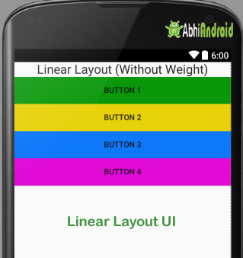
Output:
KLE Society’s College of BCA RLSI Belagavi

Slide 17
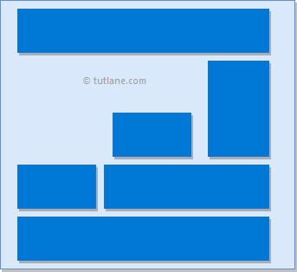
Relative Layout
The Relative Layout is very flexible layout used in android for custom layout designing.
It gives us the flexibility to position our component/view based on the relative or sibling component’s position.
KLE Society’s College of BCA RLSI Belagavi

Slide 18
For example in a class, if a Student A is sitting on a chair and the teacher of the class asks Student B to sit to the right of the Student A. Student B will know where he/she has to sit.
Similarly, the position of each view can be specified relative to its sibling elements (such as to the left-of or below another view) or in terms of position relative to the parent.
KLE Society’s College of BCA RLSI Belagavi

Slide 19
Attributes of RelativeLayout
Center relative to Parent View
android:layout_centerHorizontal="true"
This places the view horizontally in the center of the parent. As our parent view covers the whole screen of mobile therefore the view gets placed in the middle of the mobile screen horizontally.
android:layout_centerVertical="true"
This places the view vertically in the center of the parent. Since the parent view covers the whole screen of mobile hence the view gets placed in the middle of the mobile screen vertically.
android:layout_centerInParent="true"
This attribute will place the view in the center of the parent. Since the parent in our example covers the whole screen of mobile, so the view gets placed in the middle of the mobile screen, both horizontally and vertically.
KLE Society’s College of BCA RLSI Belagavi

Slide 20
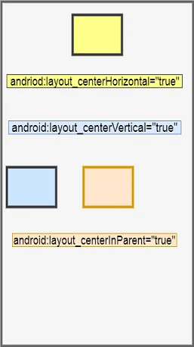
KLE Society’s College of BCA RLSI Belagavi

Slide 21
Align by the parent view
These type of attributes make the view act like a chewing gum as it can be fixed to any side of the parent view using these attributes.
android:layout_alignParentTop="true"
If you write this attribute for a View, then that view will stick to the top of its parent. Since the parent covers the whole screen of mobile therefore, the view will appear sticking to the top-left of the mobile screen.
android:layout_alignParentBottom="true"
If you write this attribute for a View, then that view will stick to the bottom of its parent. Since the our parent covers the whole screen of mobile therefore, the view will appear sticking to the bottom of the mobile screen.
android:layout_alignParentLeft="true"
If you write this attribute for a View, then that view will stick to the left of its parent. Since the parent in our example covers the whole screen of mobile therefore, the view will appear sticking to the left of the mobile screen.
android:layout_alignParentRight="true"
If you write this attribute for a View, then that view will stick to the right of its parent.
KLE Society’s College of BCA RLSI Belagavi

Slide 22
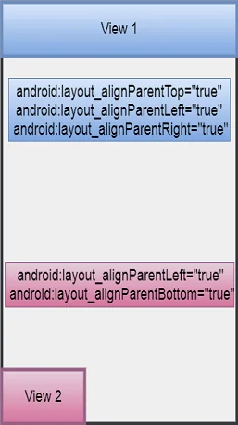
KLE Society’s College of BCA RLSI Belagavi

Slide 23
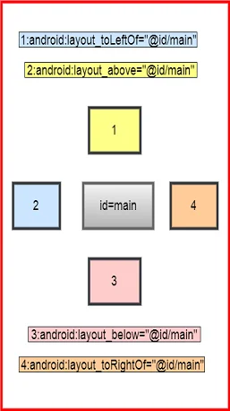
Place new View relative to existing sibling View
KLE Society’s College of BCA RLSI Belagavi

Slide 24
android:layout_toLeftOf="@id/main"
This tells the new view that you have to be on the left side of the view whose id is main.
android:layout_toRightOf="@id/main"
This tells the new view that you have to be on the right side of the view whose id is main.
android:layout_above="@id/main"
This tells the new view that you have to be above the view whose id is main
android:layout_below="@id/main"
This tells the new view that you have to be below the view whose id is main.
KLE Society’s College of BCA RLSI Belagavi

Slide 25
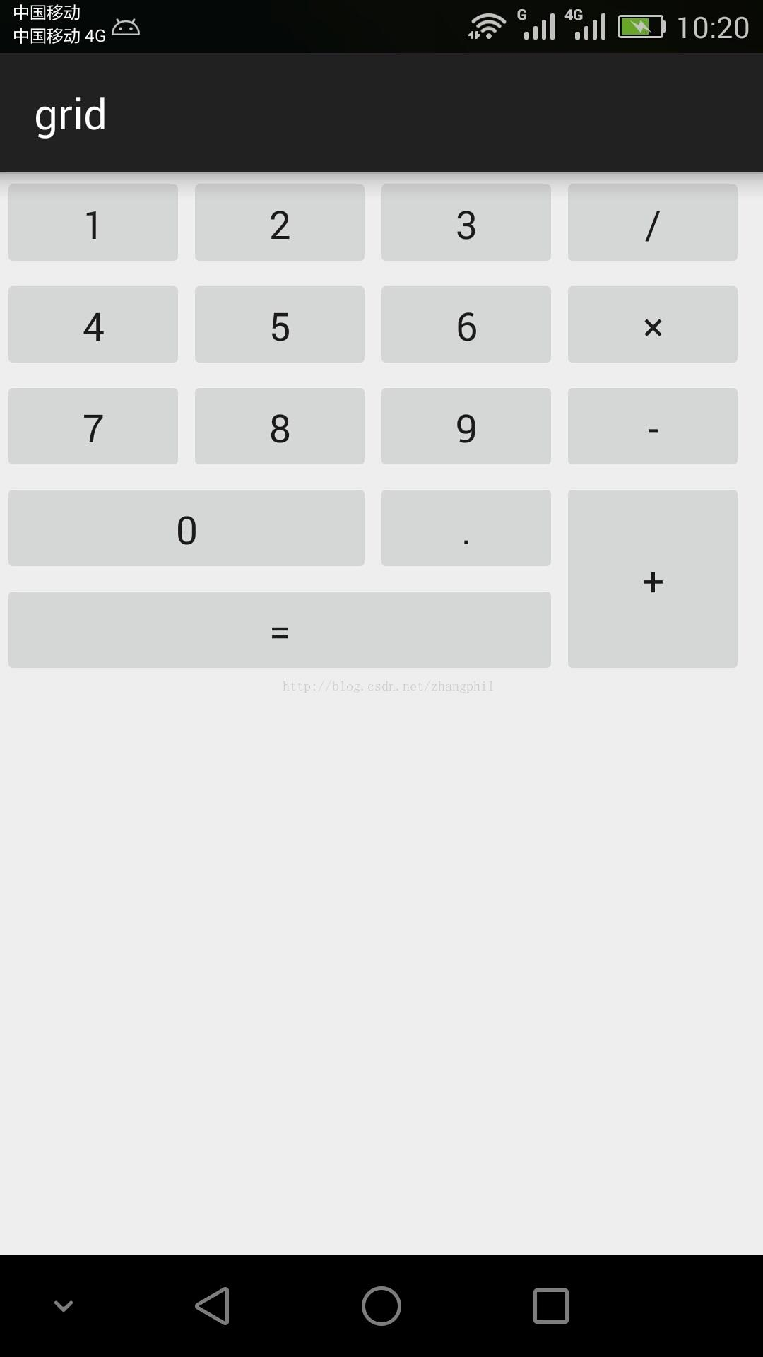
GridLayout
The GridLayout is used to arrange the components in rectangular grid. One component is displayed in each rectangle
KLE Society’s College of BCA RLSI Belagavi

Slide 26
Attributes of Android GridLayout:
android:alignmentMode – It sets the alignment of the margins and the boundaries.
android:columnCount – It sets the maximum number of columns to create when positioning children automatically.
android:columnOrderPreserved – It ensures that the column boundaries appear in the same order as its column indices.
android:rowCount – It set the maximum no. of rows to create when positioning children automatically.
android:rowOrderPreserved -It ensures that the row boundaries appear in the same order as its row indices.
android:useDefaultMargins – It tells the GridLayout to use margins if no margin is specified in the parameter. For this, it needs to be set on True.
KLE Society’s College of BCA RLSI Belagavi

Slide 27
<?xml version="1.0" encoding="utf-8"?>
<GridLayout xmlns:android="http://schemas.android.com/apk/res/android"
android:layout_width="wrap_content"
android:layout_height="wrap_content"
android:columnCount="4"
android:orientation="horizontal"
android:rowCount="5" >
<Button
android:id="@+id/one"
android:text="1" />
<Button
android:id="@+id/two"
android:text="2" />
<Button
android:id="@+id/three"
android:text="3" />
<Button
android:id="@+id/devide"
android:text="/" />
<Button
android:id="@+id/four"
android:text="4" />
<Button
android:id="@+id/five"
android:text="5" />
<Button
android:id="@+id/six"
android:text="6" />
<Button
android:id="@+id/multiply"
android:text="×" />
<Button
android:id="@+id/seven"
android:text="7" />
<Button
android:id="@+id/eight"
android:text="8" />
<Button
android:id="@+id/nine"
android:text="9" />
<Button
android:id="@+id/minus"
android:text="-" />
<Button
android:id="@+id/zero"
android:layout_columnSpan="2"
android:layout_gravity="fill"
android:text="0" />
<Button
android:id="@+id/point"
android:text="." />
<Button
android:id="@+id/plus"
android:layout_gravity="fill"
android:layout_rowSpan="2"
android:text="+" />
<Button
android:id="@+id/equal"
android:layout_columnSpan="3"
android:layout_gravity="fill"
android:text="=" />
</GridLayout>
KLE Society’s College of BCA RLSI Belagavi

Slide 28
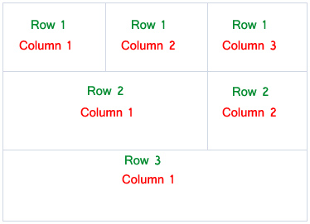
TableLayout
A TableLayout is a ViewGroup that arranges its children i.e Views and other Layouts in a table form with rows and columns. To define a row, you can use <TableRow> tag inside this layout.
KLE Society’s College of BCA RLSI Belagavi

Slide 29
Important Points About Table Layout In Android:
For building a row in a table we will use the <TableRow> element. Table row objects are the child views of a table layout.
Each row of the table has zero or more cells and each cell can hold only one view object like ImageView, TextView or any other view.
Total width of a table is defined by its parent container
Column can be both stretchable and shrinkable. If shrinkable then the width of column can be shrunk to fit the table into its parent object and if stretchable then it can expand in width to fit any extra space available.
KLE Society’s College of BCA RLSI Belagavi

Slide 30
KLE Society’s College of BCA RLSI Belagavi

Slide 31
<?xml version="1.0" encoding="utf-8"?>
<TableLayout xmlns:android="http://schemas.android.com/apk/res/android"
android:layout_width="match_parent"
android:layout_height="match_parent"
android:layout_marginTop="100dp"
android:paddingLeft="10dp"
android:paddingRight="10dp" >
<TableRow android:background="#0079D6" android:padding="5dp">
<TextView
android:layout_width="wrap_content"
android:layout_height="wrap_content"
android:layout_weight="1"
android:text="UserId" />
<TextView
android:layout_width="wrap_content"
android:layout_height="wrap_content"
android:layout_weight="1"
android:text="User Name" />
<TextView
android:layout_width="wrap_content"
android:layout_height="wrap_content"
android:layout_weight="1"
android:text="Location" />
</TableRow>
<TableRow android:background="#DAE8FC" android:padding="5dp">
<TextView
android:layout_width="wrap_content"
android:layout_height="wrap_content"
android:layout_weight="1"
android:text="1" />
<TextView
android:layout_width="wrap_content"
android:layout_height="wrap_content"
android:layout_weight="1"
android:text="Suresh Dasari" />
<TextView
android:layout_width="wrap_content"
android:layout_height="wrap_content"
android:layout_weight="1"
android:text="Hyderabad" />
</TableRow>
KLE Society’s College of BCA RLSI Belagavi

Slide 32
<TableRow android:background="#DAE8FC" android:padding="5dp">
<TextView
android:layout_width="wrap_content"
android:layout_height="wrap_content"
android:layout_weight="1"
android:text="3" />
<TextView
android:layout_width="wrap_content"
android:layout_height="wrap_content"
android:layout_weight="1"
android:text="Trishika Dasari" />
<TextView
android:layout_width="wrap_content"
android:layout_height="wrap_content"
android:layout_weight="1"
android:text="Guntur" />
</TableRow>
</TableLayout>
<TableRow android:background="#DAE8FC" android:padding="5dp">
<TextView
android:layout_width="wrap_content"
android:layout_height="wrap_content"
android:layout_weight="1"
android:text="2" />
<TextView
android:layout_width="wrap_content"
android:layout_height="wrap_content"
android:layout_weight="1"
android:text="Rohini Alavala" />
<TextView
android:layout_width="wrap_content"
android:layout_height="wrap_content"
android:layout_weight="1"
android:text="Guntur" />
</TableRow>
KLE Society’s College of BCA RLSI Belagavi

Slide 33
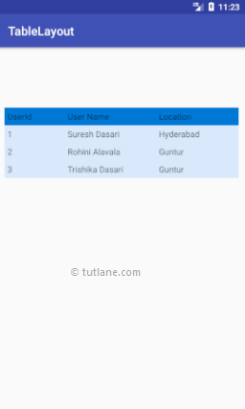
KLE Society’s College of BCA RLSI Belagavi

Slide 34
Android Fragments
Android Fragment is the part of activity, it is also known as sub-activity.
There can be more than one fragment in an activity. Fragments represent multiple screen inside one activity.
Android fragment lifecycle is affected by activity lifecycle because fragments are included in activity.
KLE Society’s College of BCA RLSI Belagavi

Slide 35
Each fragment has its own life cycle methods that is affected by activity life cycle because fragments are embedded in activity.
The FragmentManager class is responsible to make interaction between fragment objects.
KLE Society’s College of BCA RLSI Belagavi

Slide 36
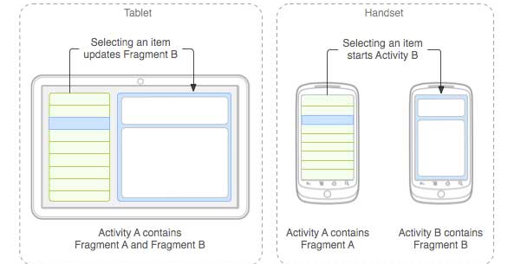
KLE Society’s College of BCA RLSI Belagavi

Slide 37
Following are important points about fragment −
A fragment has its own layout and its own behavior with its own life cycle callbacks.
You can add or remove fragments in an activity while the activity is running.
You can combine multiple fragments in a single activity to build a multi-pane UI.
A fragment can be used in multiple activities.
KLE Society’s College of BCA RLSI Belagavi

Slide 38
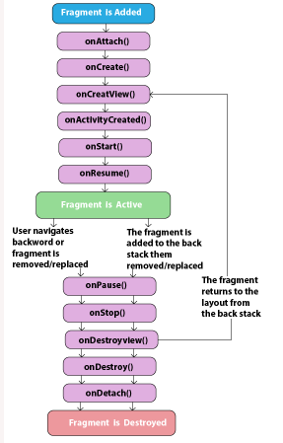
Fragment Life Cycle
KLE Society’s College of BCA RLSI Belagavi

Slide 39
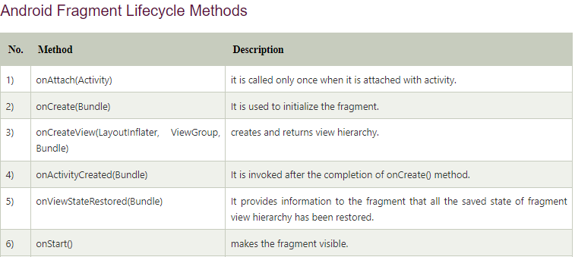
KLE Society’s College of BCA RLSI Belagavi

Slide 40
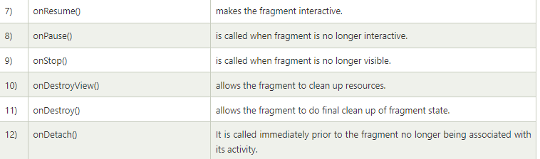
KLE Society’s College of BCA RLSI Belagavi

Slide 41
Android Fragment Example
<?xml version="1.0" encoding="utf-8"?>
<LinearLayout xmlns:android="http://schemas.android.com/apk/res/android"
xmlns:app="http://schemas.android.com/apk/res-auto"
xmlns:tools="http://schemas.android.com/tools"
android:layout_width="fill_parent"
android:layout_height="fill_parent"
tools:context="example.javatpoint.com.fragmentexample.MainActivity">
<fragment
android:id="@+id/fragment1"
android:name="example.javatpoint.com.fragmentexample.Fragment1"
android:layout_width="0px"
android:layout_height="match_parent"
android:layout_weight="1"
/>
<fragment
android:id="@+id/fragment2"
android:name="example.javatpoint.com.fragmentexample.Fragment2"
android:layout_width="0px"
android:layout_height="match_parent"
android:layout_weight="1"
/>
</LinearLayout>
KLE Society’s College of BCA RLSI Belagavi

Slide 42
<FrameLayout xmlns:android="http://schemas.android.com/apk/res/android"
xmlns:tools="http://schemas.android.com/tools"
android:layout_width="match_parent"
android:layout_height="match_parent"
android:background="#F5F5DC"
tools:context="example.javatpoint.com.fragmentexample.Fragment1">
<!-- TODO: Update blank fragment layout -->
<TextView
android:layout_width="match_parent"
android:layout_height="match_parent"
android:text="@string/hello_blank_fragment" />
</FrameLayout>
KLE Society’s College of BCA RLSI Belagavi

Slide 43
<FrameLayout xmlns:android="http://schemas.android.com/apk/res/android"
xmlns:tools="http://schemas.android.com/tools"
android:layout_width="match_parent"
android:layout_height="match_parent"
android:background="#F0FFFF"
tools:context="example.javatpoint.com.fragmentexample.Fragment2">
<!-- TODO: Update blank fragment layout -->
<TextView
android:layout_width="match_parent"
android:layout_height="match_parent"
android:text="@string/hello_blank_fragment" />
</FrameLayout>
KLE Society’s College of BCA RLSI Belagavi

Slide 44
//File: MainActivity.java
package example.javatpoint.com.fragmentexample;
import android.support.v7.app.AppCompatActivity;
import android.os.Bundle;
public class MainActivity extends AppCompatActivity {
@Override
protected void onCreate(Bundle savedInstanceState) {
super.onCreate(savedInstanceState);
setContentView(R.layout.activity_main);
}
}
//File: Fragment1.java
public class Fragment1 extends Fragment {
@Override
public void onCreate(Bundle savedInstanceState) {
super.onCreate(savedInstanceState);
}
@Override
public View onCreateView(LayoutInflater inflater, ViewGroup container,
Bundle savedInstanceState) {
// Inflate the layout for this fragment
return inflater.inflate(R.layout.fragment_fragment1, container, false);
}
}
KLE Society’s College of BCA RLSI Belagavi

Slide 45
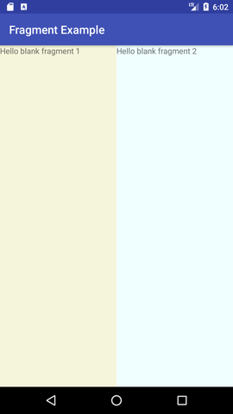
File: Fragment2.java
public class Fragment2 extends Fragment {
@Override
public void onCreate(Bundle savedInstanceState) {
super.onCreate(savedInstanceState);
}
@Override
public View onCreateView(LayoutInflater inflater, ViewGroup container,
Bundle savedInstanceState) {
// Inflate the layout for this fragment
return inflater.inflate(R.layout.fragment_fragment2, container, false);
}
}
KLE Society’s College of BCA RLSI Belagavi

Slide 46
Adapter
Adapter and Adapter View are so popular, that every time you see any app with a List of items or Grid of items, you can say for sure that it is using Adapter and Adapter View.
Generally, when we create any List or Grid of data, we think we can use a loop to iterate over the data and then set the data to create the list or grid.
But what if the data is a set of 1 million products. Then using a loop will not only consume a lot of time, making the app slow, also it might end up eating all the runtime memory.
All these problems are solved by using Adapter and Adapter View.
KLE Society’s College of BCA RLSI Belagavi

Slide 47
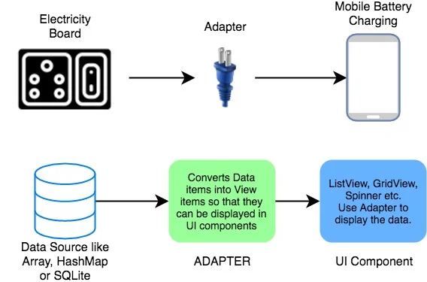
KLE Society’s College of BCA RLSI Belagavi

Slide 48
What is an Adapter?
An adapter acts like a bridge between a data source and the user interface. It reads data from various data sources, coverts it into View objects and provide it to the linked Adapter view to create UI components.
The data source or dataset can be an Array object, a List object etc.
KLE Society’s College of BCA RLSI Belagavi

Slide 49
Adapters In Android:
There are the some commonly used Adapter in Android used to fill the data in the UI components.
BaseAdapter – It is parent adapter for all other adapters
ArrayAdapter – It is used whenever we have a list of single items which is backed by an array
Custom ArrayAdapter – It is used whenever we need to display a custom list
SimpleAdapter – It is an easy adapter to map static data to views defined in your XML file
Custom SimpleAdapter – It is used whenever we need to display a customized list and needed to access the child items of the list or grid
KLE Society’s College of BCA RLSI Belagavi

Slide 50
Define the Adapter
There will be an Adapter(ArrayAdapter etc) to take data from data source, create a view of it and then pass it to the AdapterView i.e. Spinner.
ArrayAdapter<String> adapter = new ArrayAdapter<>(this, android.R.layout.simple_spinner_item, days);
There are 3 parameters used to instantiate an ArrayAdapter(we have used an ArrayAdapter in our example):
Context c: Refers to the current class object where ArrayAdapter is being instantiated.
Layout: It is a layout file that defines how a single item will appear in the spinner. Android SDK by default provides layouts like simple_spinner_item and simple_spinner_dropdown_item and if you do not have any special design requirements, we suggest you use these only.
Data source: It is the data source from which data will be converted into a view.
KLE Society’s College of BCA RLSI Belagavi

Slide 51
<?xml version="1.0" encoding="utf-8"?>
<RelativeLayout
xmlns:android="http://schemas.android.com/apk/res/android"
xmlns:tools="http://schemas.android.com/tools"
android:layout_width="match_parent"
android:layout_height="match_parent"
tools:context=".MainActivity">
<ListView
android:id="@+id/simpleListView"
android:layout_width="match_parent"
android:layout_height="wrap_content" />
</RelativeLayout>
KLE Society’s College of BCA RLSI Belagavi

Slide 52
This will contain a TextView that is used to display the array objects as output.
<?xml version="1.0" encoding="utf-8"?>
<LinearLayout
xmlns:android="http://schemas.android.com/apk/res/android"
android:layout_width="match_parent"
android:layout_height="match_parent"
android:orientation="vertical">
<TextView
android:id="@+id/itemTextView"
android:layout_width="match_parent"
android:layout_height="wrap_content"
android:layout_gravity="center" />
</LinearLayout>
KLE Society’s College of BCA RLSI Belagavi

Slide 53
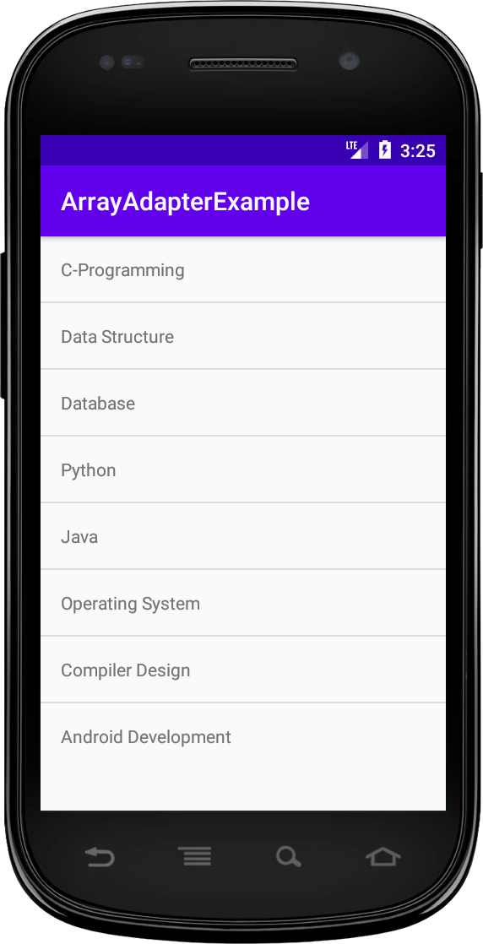
public class MainActivity extends AppCompatActivity {
ListView simpleListView;
// array objects
String courseList[] = {"C-Programming", "Data Structure", "Database", "Python",
"Java", "Operating System", "Compiler Design", "Android Development"};
@Override
protected void onCreate(Bundle savedInstanceState) {
super.onCreate(savedInstanceState);
setContentView(R.layout.activity_main);
simpleListView = (ListView) findViewById(R.id.simpleListView);
ArrayAdapter<String> arrayAdapter = new ArrayAdapter<String>(this,
R.layout.item_view, R.id.itemTextView, courseList);
simpleListView.setAdapter(arrayAdapter);
}
}
KLE Society’s College of BCA RLSI Belagavi

